Slide 1
TETHER SATELLITE SYSTEM DYNAMICS MODELLING
Chen Kaiwen
co-worked with Dr. Pok Wang KWAN
Supervised by Prof Xun Huang
Master of Science in Aeronautical Engineering
Department of Mechanical and Aerospace Engineering
School of Engineering HKUST
May. 2018

Slide 2
Outline
Motivation
Literature Review and Case Study
Detection using ArduSat Demosat
Wireless communication Setup
Testbed fabricating
Acknowledgement

Slide 3
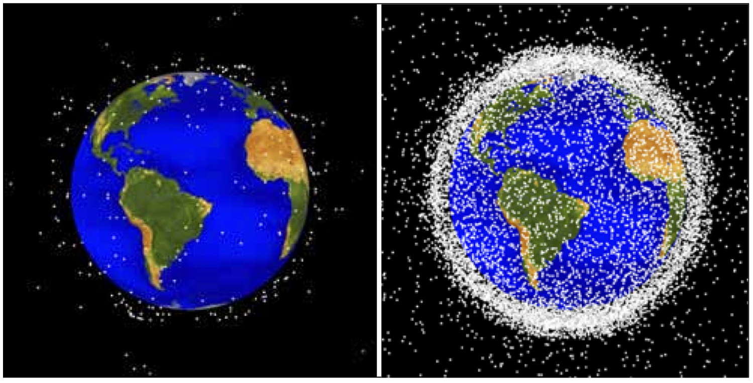
Motivation
The Earth is surrounded by tens of thousands of sizeable chunks of debris orbiting at very high speeds
Add to these larger pieces debris an estimated hundreds of thousands of sub-centimeter-sized artificial particles
A source for potential disaster—for while these small particles may not seem imposing, they can present a serious threat to functional spacecraft.
Tracked space debris in 1963 and fifty years later in 2013.
Image credit: NASA

Slide 4
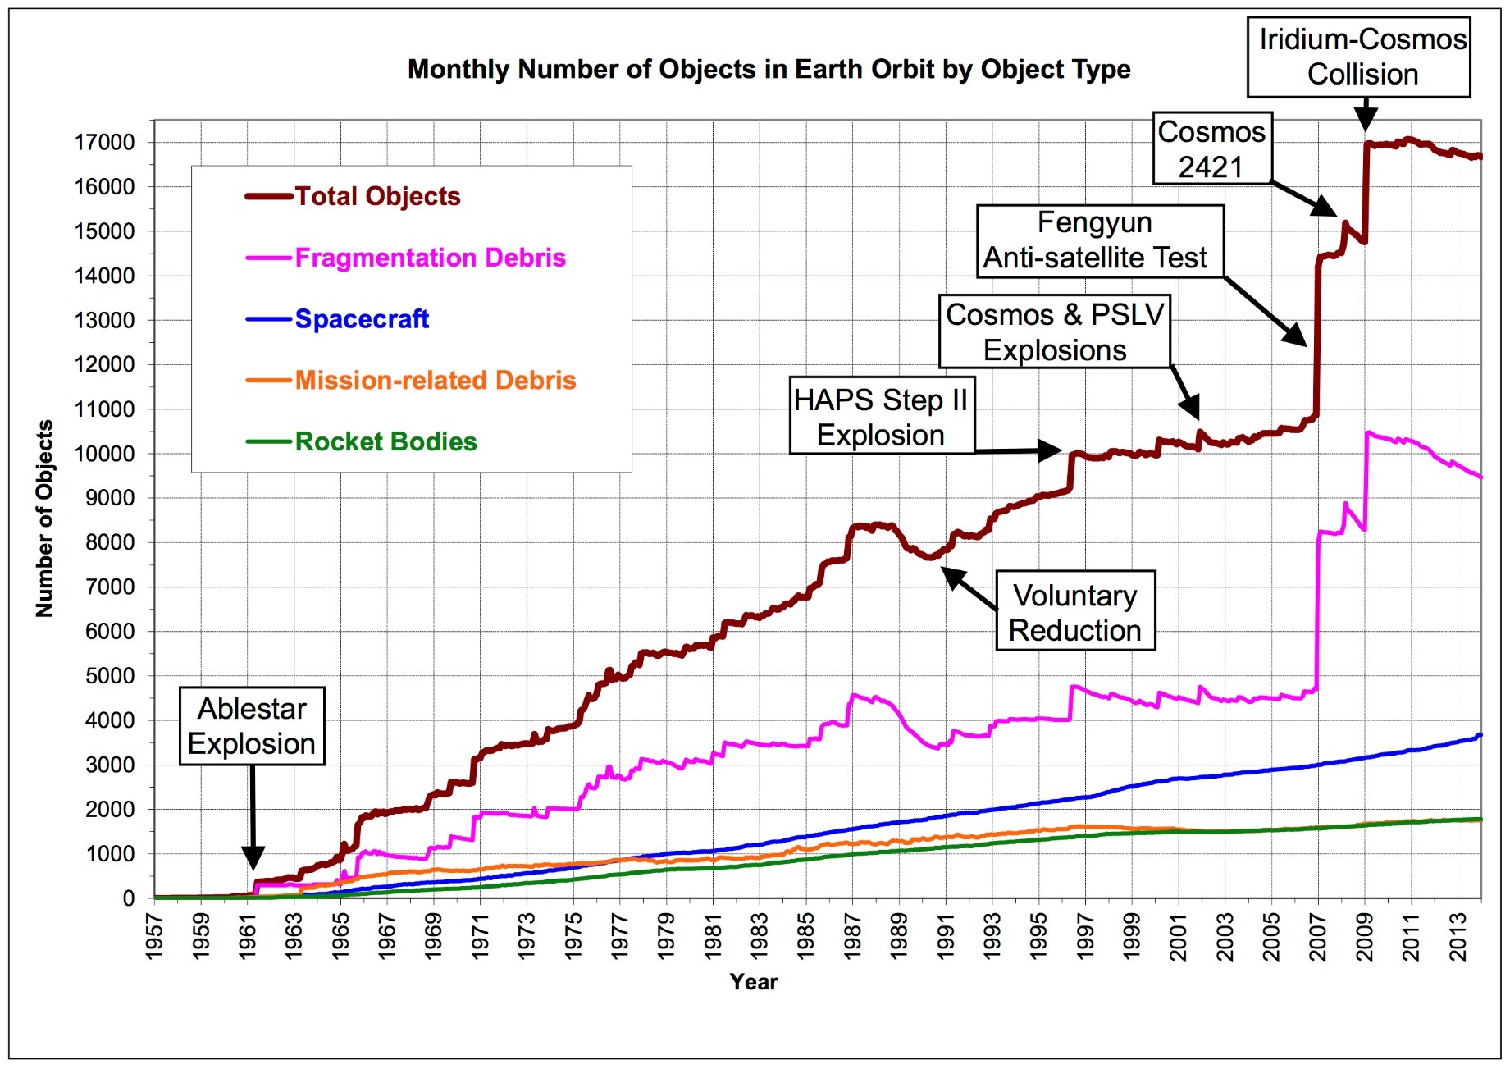
Motivation
Debris Kind:
Fragmentation Debris
Spacecraft
Mission-related Debris
Rocket Bodies
Other sources
Debris changing trend over nearly 60 years
——From 1957 to 2013
“Since 2002 ,The growth(of space debris) has entered into the more feared exponential trend.”
——Donald Kessler: former NASA scientist

Slide 5
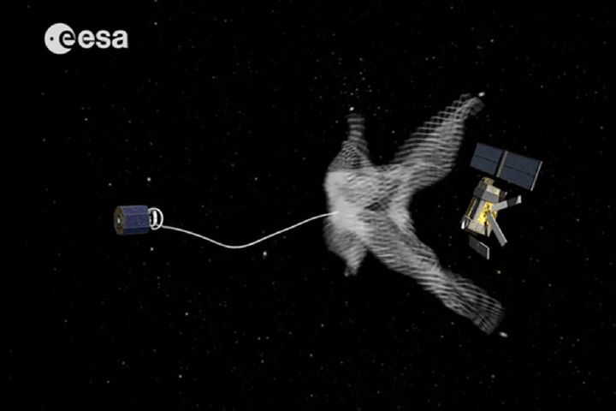
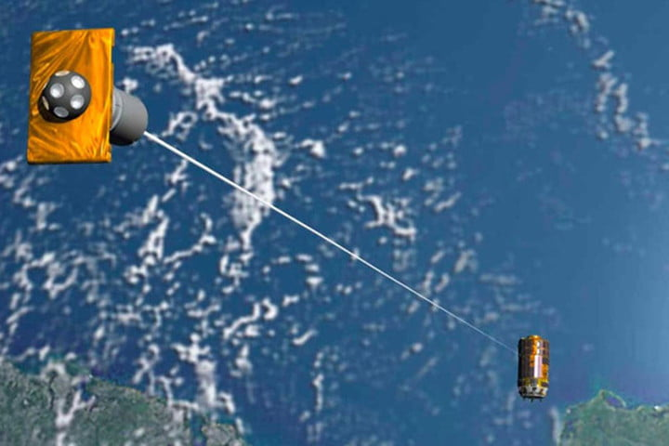
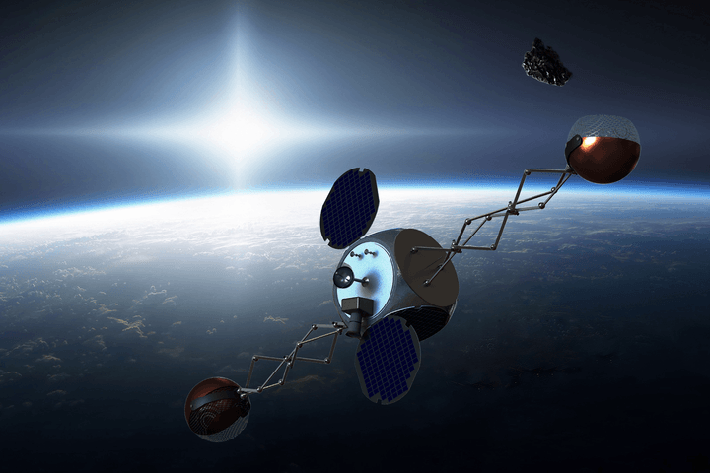
Motivation
Actively Removing Space Debris
ESA's e.Deorbit space debris collection mission. Credit: ESA
Artist's rendition of the JAXA space debris collection mission. Credit: JAXA
A space debris removal satellite, dubbed Sling-Sat, designed at Texas A&M University.

Slide 6
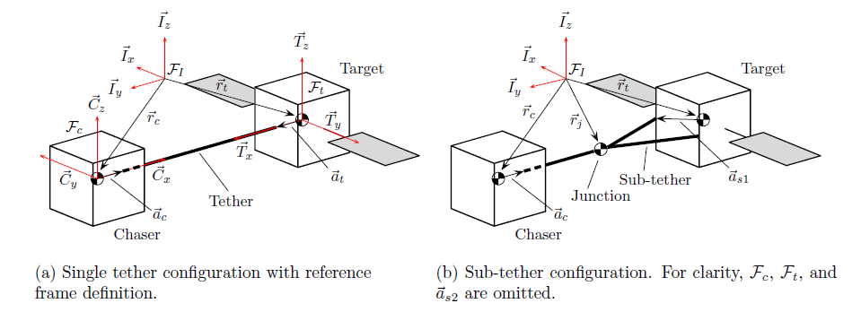
Literature Review
Hovell, K., & Ulrich, S. (2017). Experimental Validation for Tethered Capture of Spinning Space Debris. In AIAA Guidance, Navigation, and Control Conference (p. 1049).
Operating state:3-degree freedom of motion, X Y and rotation
New configuration idea: Sub-tether configuration
Key physical quantities: Target tether angle ; Target angular rate; Total angular momentum
Goal: Decrease all the key physical quantities much quicker to make space debris deorbit practically

Slide 7
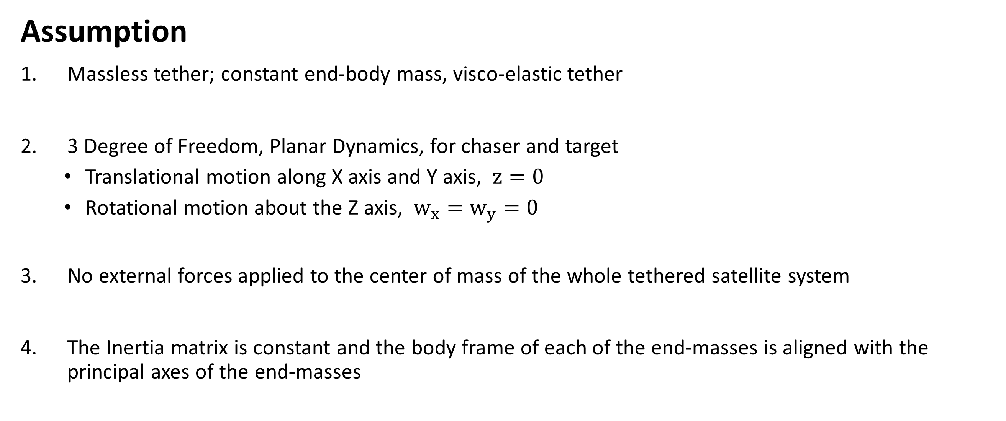
Literature Review
Assumption
Massless tether; constant end-body mass, visco-elastic tether
3 Degree of Freedom, Planar Dynamics, for chaser and target
Translational motion along X axis and Y axis, $z=0$
Rotational motion about the Z axis, $w_{x}=w_{y}=0$
No external forces applied to the center of mass of the whole tethered satellite system
The Inertia matrix is constant and the body frame of each of the end-masses is aligned with the principal axes of the end-masses

Slide 8
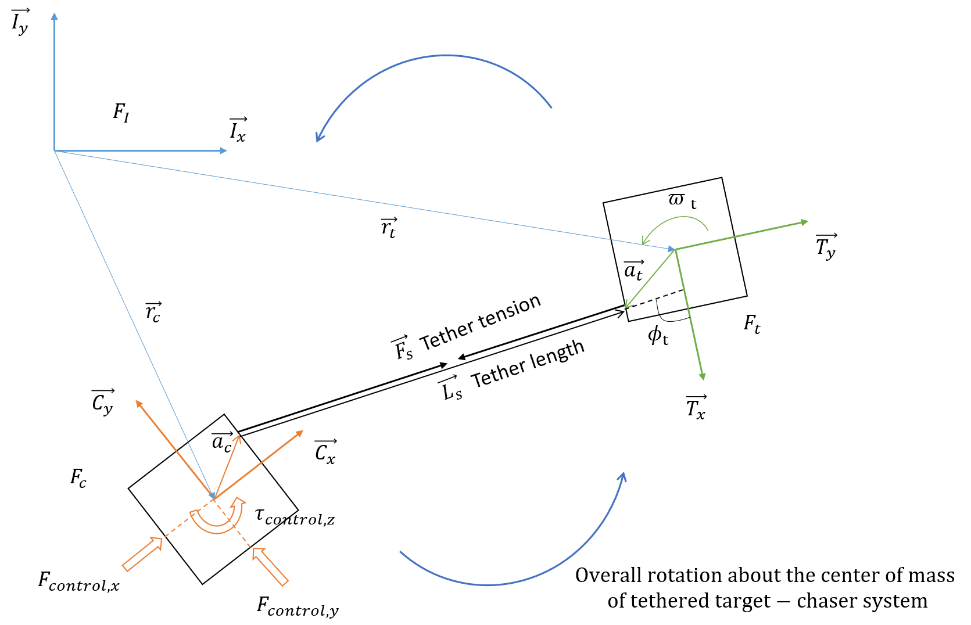
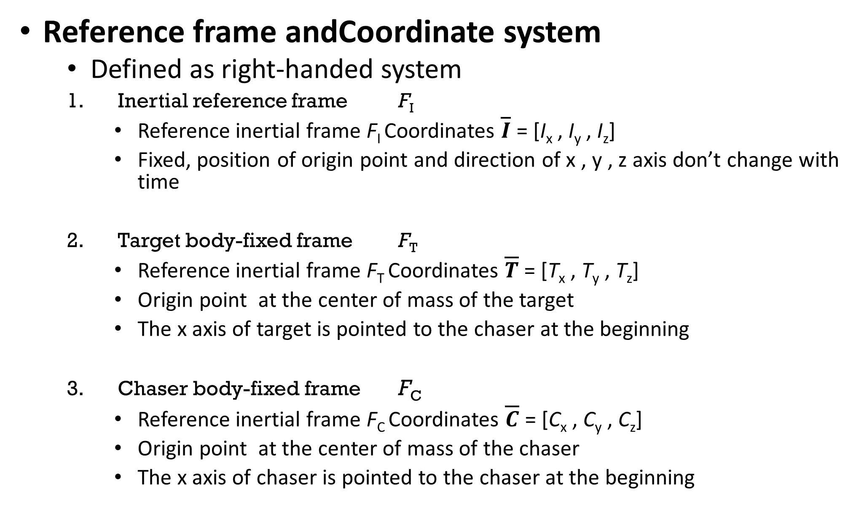
Literature Review
Reference frame andCoordinate system
Defined as right-handed system
Inertial reference frame F_{I}
Reference inertial frame F_{I} Coordinates $\overline{I}$ = [I_{x} , I_{y} , I_{z}]
Fixed, position of origin point and direction of x , y , z axis don’t change with time
Target body-fixed frame F_{T}
Reference inertial frame F_{T} Coordinates $\overline{T}$ = [T_{x} , T_{y} , T_{z}]
Origin point at the center of mass of the target
The x axis of target is pointed to the chaser at the beginning
Chaser body-fixed frame F_{C}
Reference inertial frame F_{C} Coordinates $\overline{C}$ = [C_{x} , C_{y} , C_{z}]
Origin point at the center of mass of the chaser
The x axis of chaser is pointed to the chaser at the beginning

Slide 9
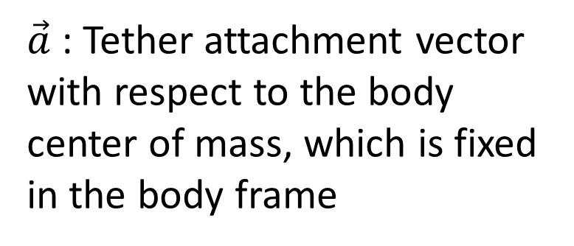
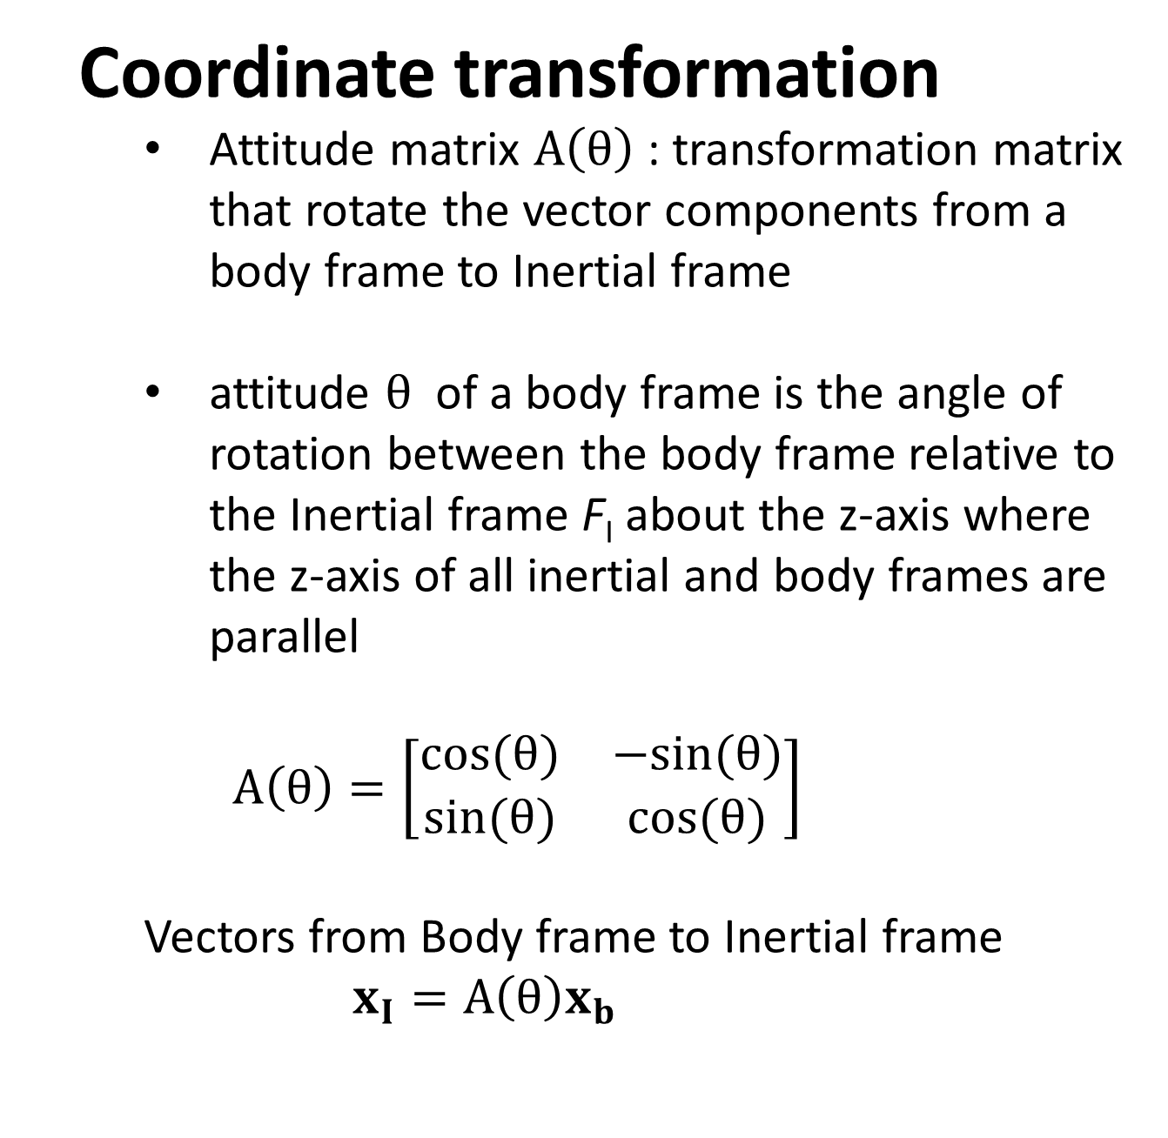
Literature Review
Coordinate transformation
Attitude matrix $A\left(θ\right)$ : transformation matrix that rotate the vector components from a body frame to Inertial frame
attitude $θ$ of a body frame is the angle of rotation between the body frame relative to the Inertial frame F_{I} about the z-axis where the z-axis of all inertial and body frames are parallel
$$A\left(θ\right)=\left[\begin{matrix}cos⁡(θ) & −sin⁡(θ) \\ sin⁡(θ) & cos⁡(θ)\end{matrix}\right]$$
Vectors from Body frame to Inertial frame
$$x_{I}=A\left(θ\right)x_{b}$$
$\vec{a}$: Tether attachment vector with respect to the body center of mass, which is fixed in the body frame

Slide 10
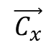
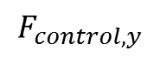
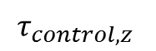
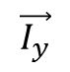
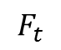
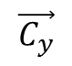
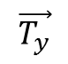
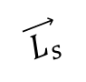
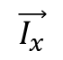
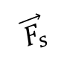
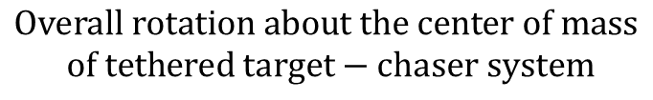
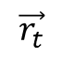
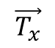
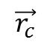
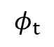
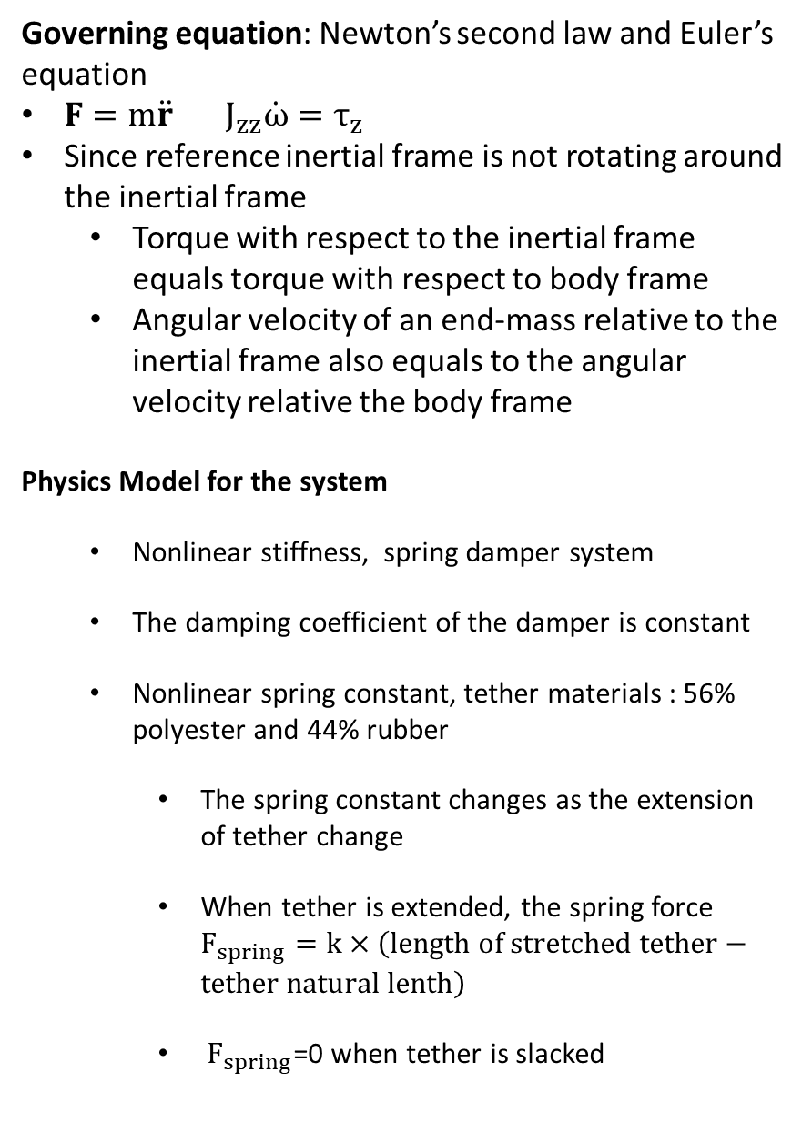
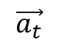
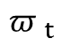
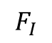
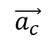
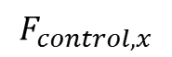
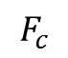
Literature Review
Governing equation: Newton’s second law and Euler’s equation
$F=m\ddot{r} J_{zz}\dot{ω}=τ_{z}$
Since reference inertial frame is not rotating around the inertial frame
Torque with respect to the inertial frame equals torque with respect to body frame
Angular velocity of an end-mass relative to the inertial frame also equals to the angular velocity relative the body frame
Physics Model for the system
Nonlinear stiffness, spring damper system
The damping coefficient of the damper is constant
Nonlinear spring constant, tether materials : 56% polyester and 44% rubber
The spring constant changes as the extension of tether change
When tether is extended, the spring force $F_{spring}=k×\left(length of stretched tether−tether natural lenth\right)$
$F_{spring}$=0 when tether is slacked
$$\vec{I_{y}}$$
$$F_{I}$$
$$\vec{I_{x}}$$
$${π }_{t}$$
$$\vec{r_{t}}$$
$$\vec{T_{y}}$$
$$\vec{a_{t}}$$
$$\vec{r_{c}}$$
Tether tension
$$F_{t}$$
$$\vec{F_{s}}$$
$$φ_{t}$$
Tether length
$$\vec{C_{y}}$$
$$\vec{L_{s}}$$
$$\vec{T_{x}}$$
$$\vec{a_{c}}$$
$$\vec{C_{x}}$$
$$F_{c}$$
$$τ_{control,z }$$
$$F_{control,x}$$
$$Overall rotation about the center of mass$$
$$of tethered target−chaser system$$
$$F_{control,y}$$

Slide 11
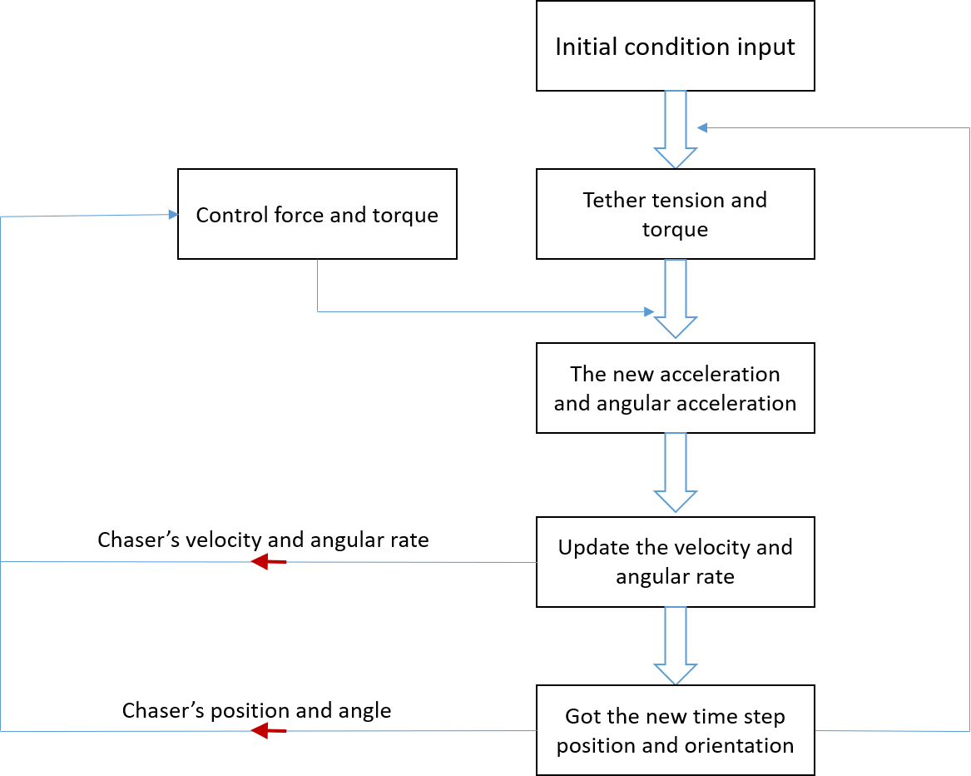
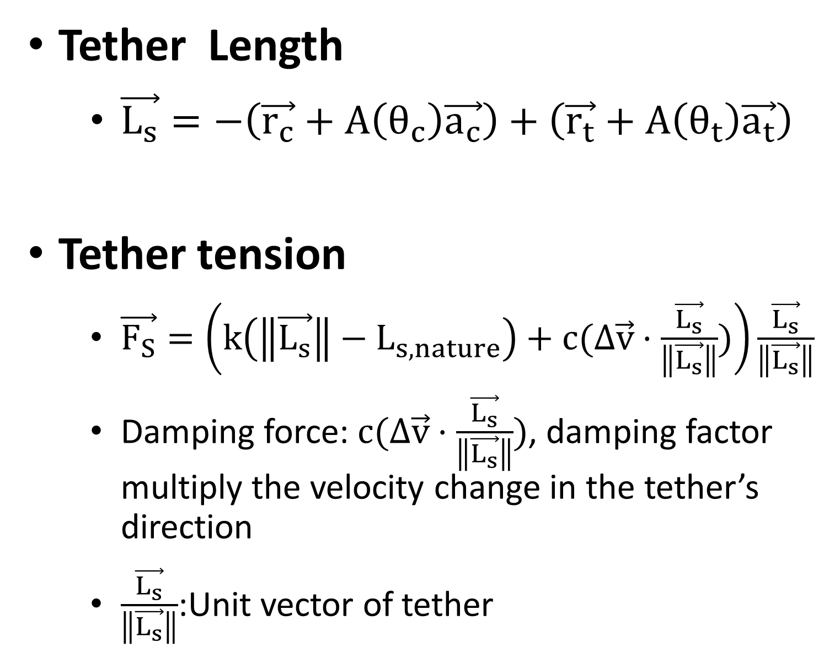
Literature Review
Tether Length
$\vec{L_{s}}=−\left(\vec{r_{c}}+A\left(θ_{c}\right)\vec{a_{c}}\right)+\left(\vec{r_{t}}+A\left(θ_{t}\right)\vec{a_{t}}\right)$
Tether tension
$\vec{F_{S}}=\left(k\left(\left\|\vec{L_{s}}\right\|−L_{s,nature}\right)+c(Δ\vec{v}·\frac{\vec{L_{s}}}{\left\|\vec{L_{s}}\right\|})\right)\frac{\vec{L_{s}}}{\left\|\vec{L_{s}}\right\|}$
Damping force: $c(Δ\vec{v}·\frac{\vec{L_{s}}}{\left\|\vec{L_{s}}\right\|})$, damping factor multiply the velocity change in the tether’s direction
$\frac{\vec{L_{s}}}{\left\|\vec{L_{s}}\right\|}$:Unit vector of tether

Slide 12
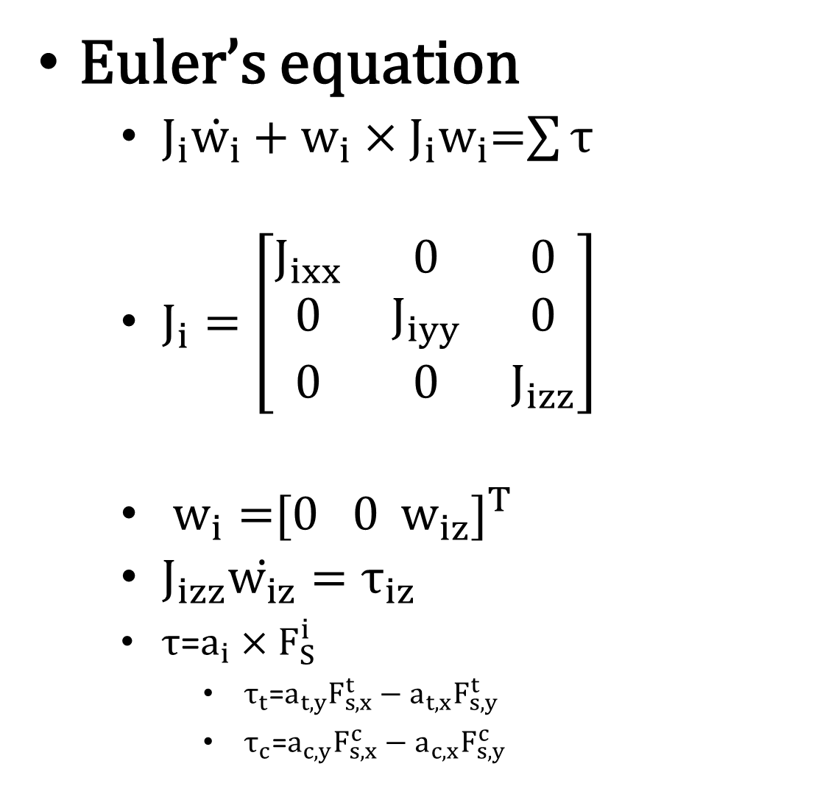
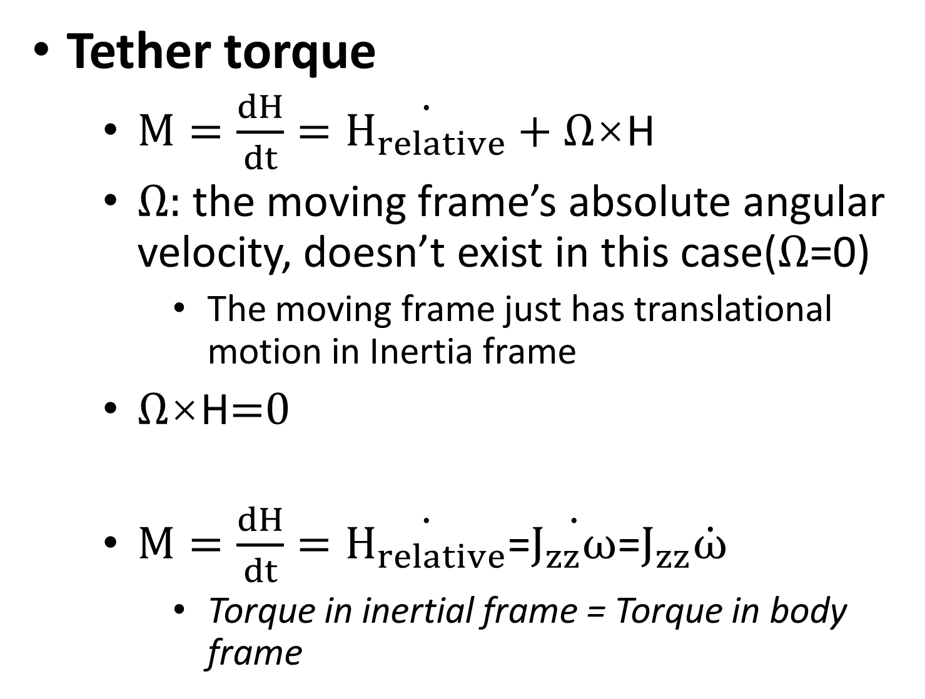
Literature Review
Euler’s equation
$J_{i}\dot{w_{i}}+w_{i}×J_{i}w_{i}$=$\sum{τ}$
$J_{i}=\left[\begin{matrix}J_{ixx} & 0 & 0 \\ 0 & J_{iyy} & 0 \\ 0 & 0 & J_{izz}\end{matrix}\right]$
$w_{i}{\text{=}[0 0{ w}_{iz}]}^{T}$
$J_{izz}\dot{w_{iz}}=τ_{iz}$
$τ$=$a_{i}×F_{S}^{i}$
$τ_{t}$=$a_{t,y}F_{s,x}^{t}−{a_{t,x}F}_{s,y}^{t}$
$τ_{c}\text{=}a_{c,y}F_{s,x}^{c}−{a_{c,x}F}_{s,y}^{c}$
Tether torque
$M=\frac{dH}{dt}=\dot{H_{relative}}+Ω\text{×}\text{H}$
$Ω:$ the moving frame’s absolute angular velocity, doesn’t exist in this case($Ω$=0)
The moving frame just has translational motion in Inertia frame
$Ω\text{×}\text{H}$=0
$M=\frac{dH}{dt}=\dot{H_{relative}}$=$\dot{J_{zz}ω}$=$J_{zz}\dot{ω}$
Torque in inertial frame = Torque in body frame

Slide 13
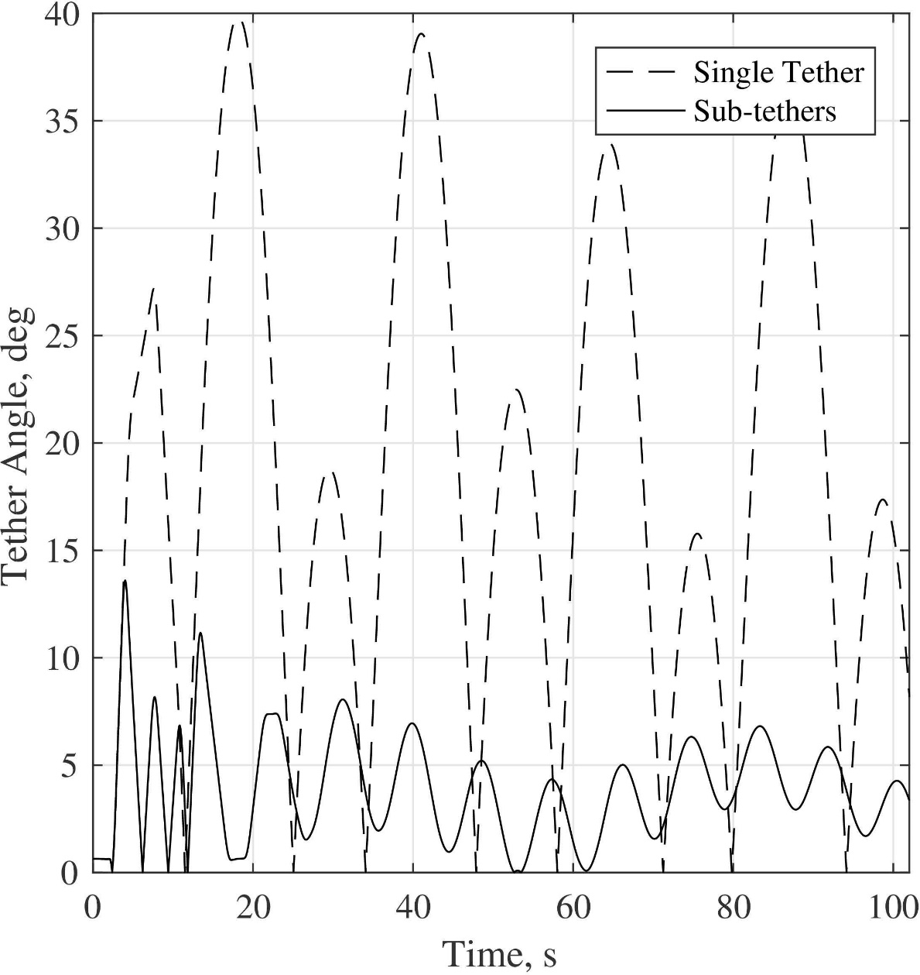
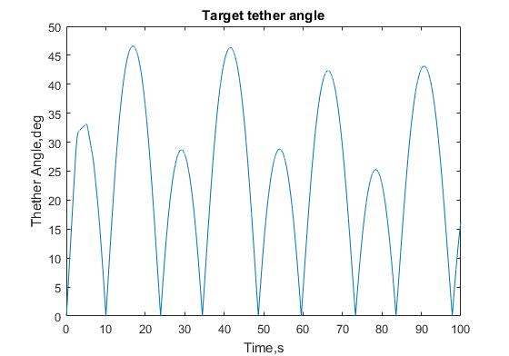
Case study
Hovell and Ulrich (2017) planar single tether thrust stabilization
- Tether angle simulation t = 1-100 s
Kirk Hovell
Kaiwen Chen

Slide 14
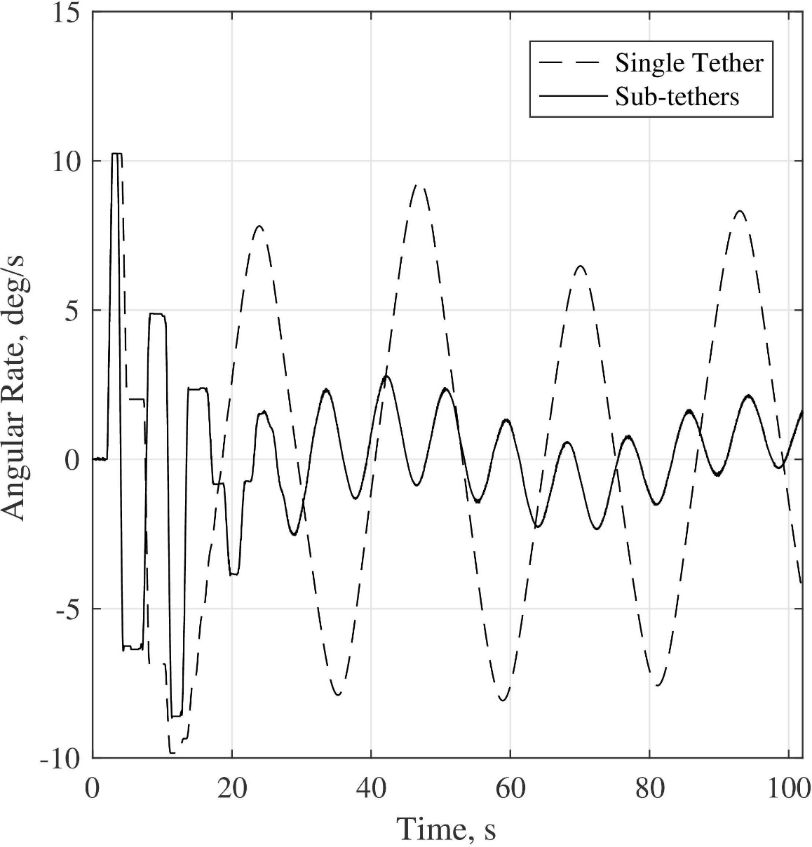
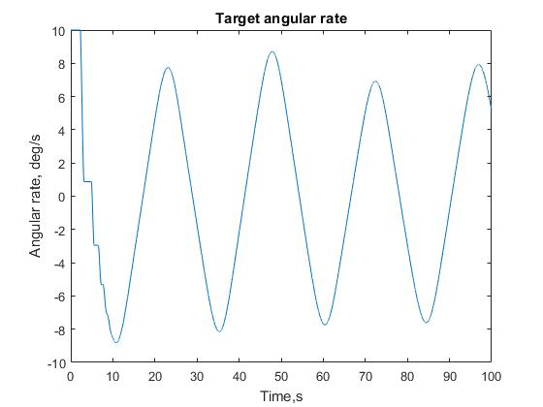
Case study
- Target vehicle angular velocity t = 1-100 s
Kirk Hovell
Kaiwen Chen

Slide 15
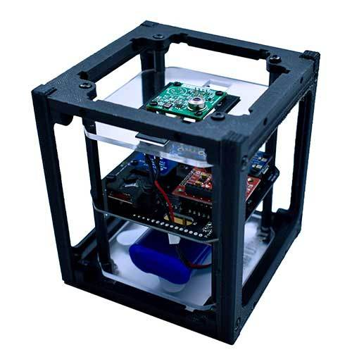
Detection using ArduSat
Arduino Cubusatellite Standard 1U Demosatellite
-Sensor board’ sensors
Accelerometer
Gyroscope
Magnetometer
Compile the Arduino Board using Arduino ino file
CSV format: include timestamp
Highest baud rate 57600 for improving motion-tracking effect
Individual written MATLAB code for real-time data plotting and recording via USB serial communication
Figure: Ardusat Demosat

Slide 16
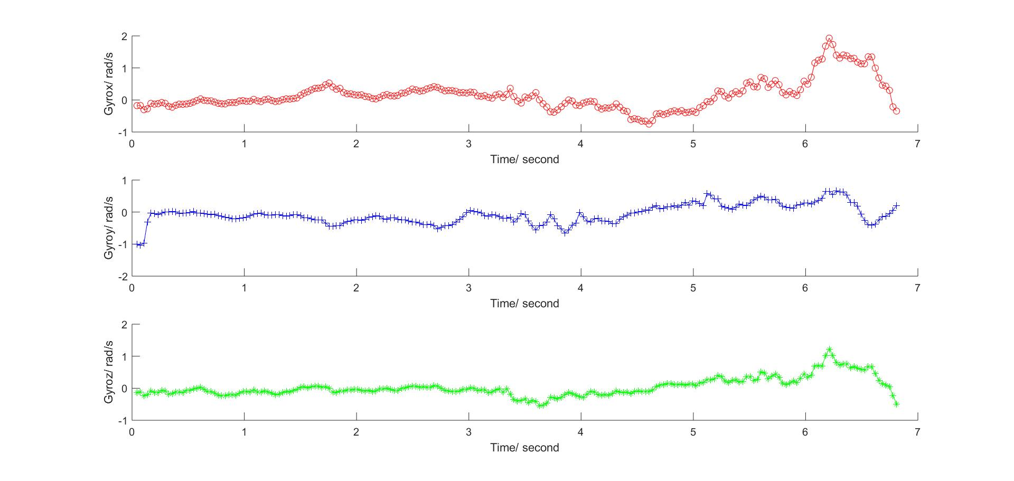
Detection using ArduSat
Update rate: 32HZ
Acceleration: Sensor LSM303 triple-axis accelerometer
Angular rates: Sensor L3GD20 three-axis gyroscope.
Orientation: derived from acceleration
and Magnetic intensity

Slide 17
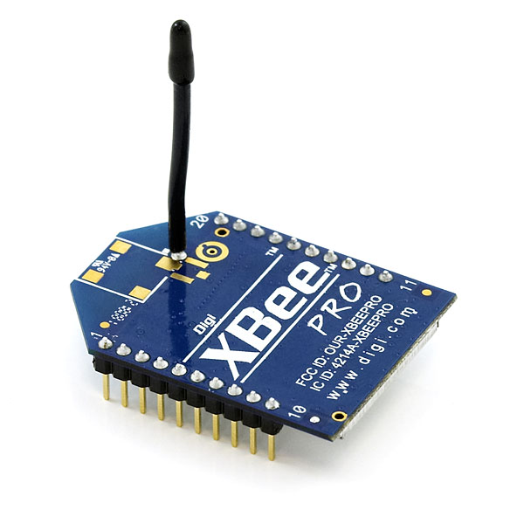
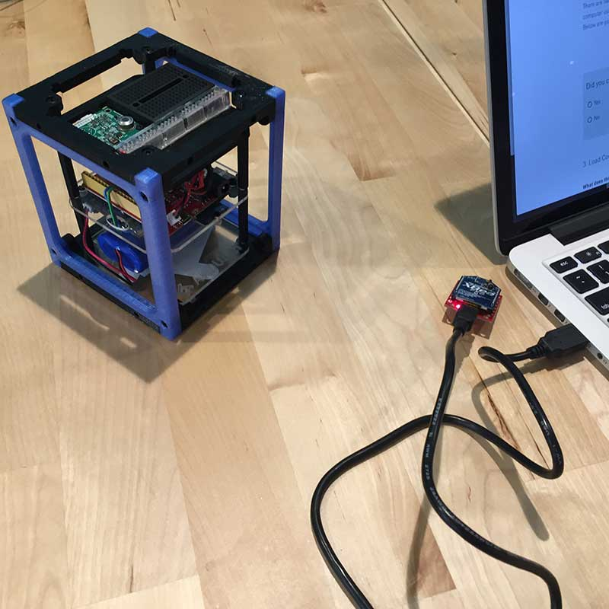
Wireless communication Setup
Xbee on Ardusat A(Target)
A network
Xbee on A Shield
Xbee on Ardusat B(Chaser)
B network
Xbee on B Shield
Figure: Illustration of one network
The two network should be separated. The wireless network transmission should not be interfered by the other network.

Slide 18
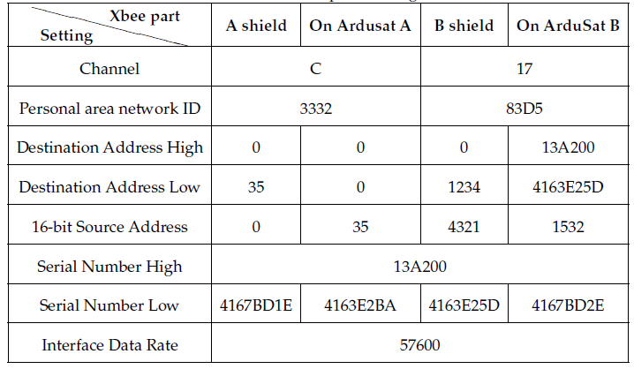
Wireless communication Setup
Archived lowest interference setting
Xbee on Ardusat A(Target)
A network
Xbee on A Shield
Xbee on Ardusat B(Chaser)
B network
Xbee on B Shield
Table: Xbee Part setting
Key point: Each following one way and against the other at the same time respectively

Slide 19
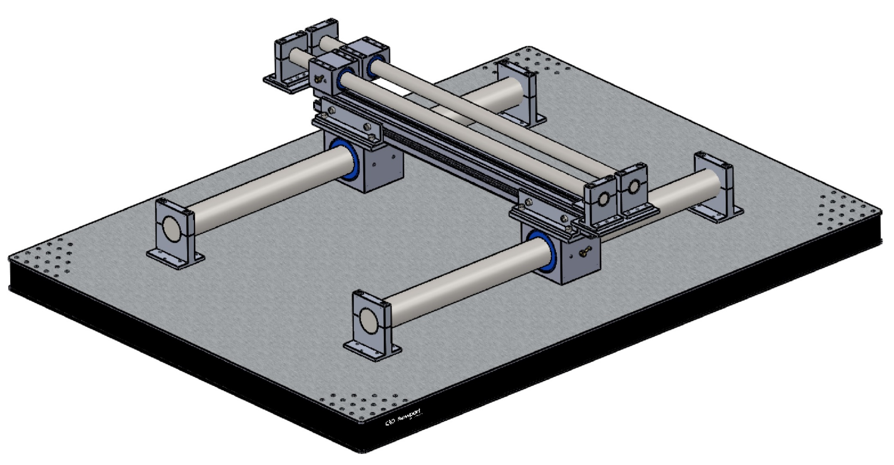
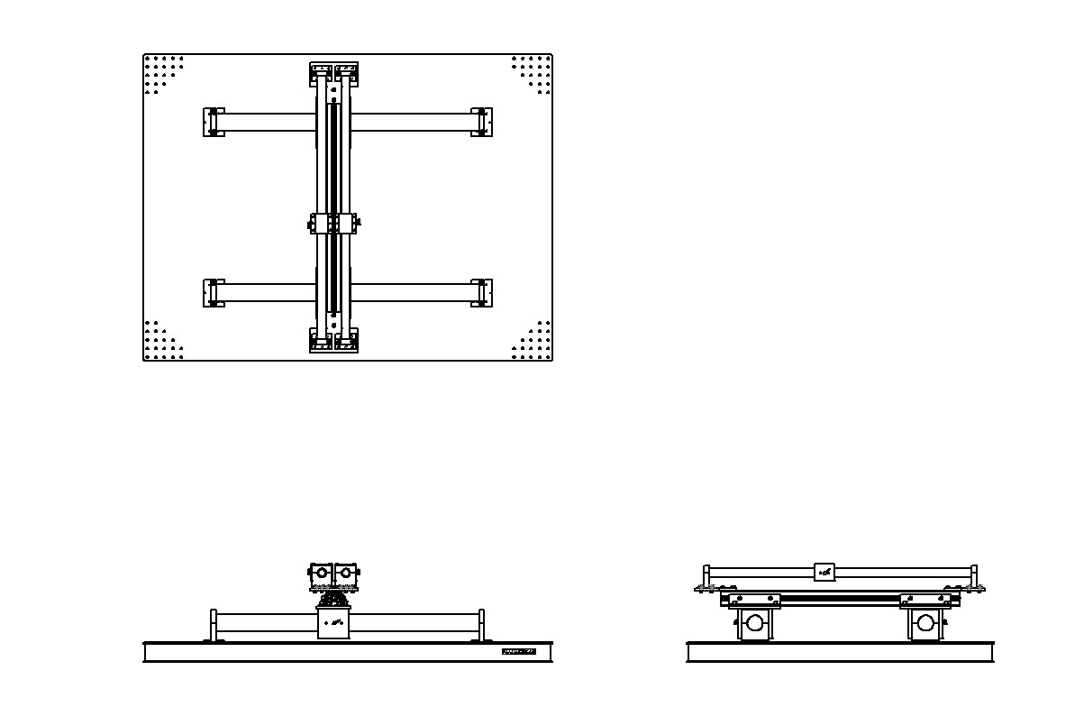
Testbed fabricating
Original model

Slide 20
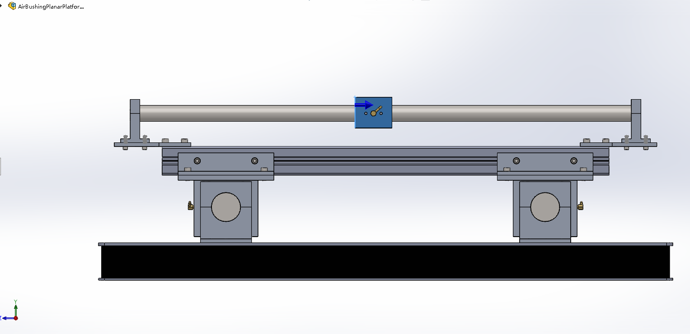
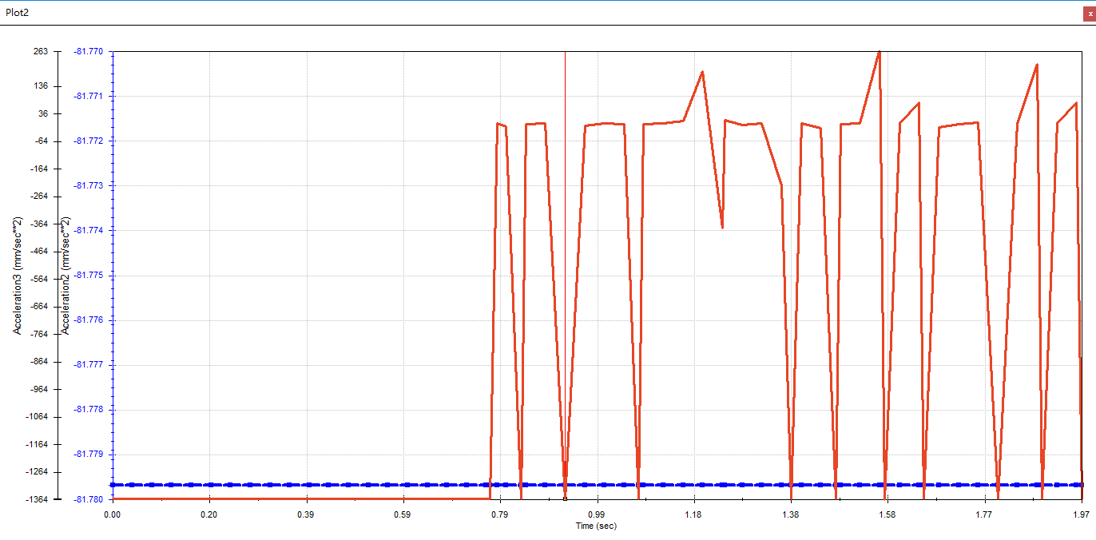

Testbed fabricating
SolidWorks Motion Analysis
Mass of Inertia along two axes are different
Using constant force along two axes
Blue line and red line shows the linear acceleration of two directions. The magnitude of them are totally different.

Slide 21



Testbed fabricating
Compensation configuration
Using two pairs of simulator and physical connection
Hanging configuration
Using string to provide additional rotational degree of freedom

Slide 22
Acknowledgement
I would like to express my special thanks of gratitude to my supervisor Prof Xun Huang ,who gave me the opportunity to do this wonderful project on the topic Tether Satellite System and generous help, as well as to my mentor Dr. Pok Wang KWAN, who devoted his time caring and helped me to manage my project.
By doing a lot of research training with him I came to know about so many new things and practiced a lot of useful skills such as MATLAB Programming, Arduino, Latex Report writing and XCTU wireless communication.
The most valuable things I learned are the self-learning skill, problem-solving logical thinking and markdown custom. I am really thankful to them.
Secondly I would also like to thank my friends and PhD colleagues who helped me a lot in finalizing this project within the limited time frame.
Thank you for listening

